Slide 1
Inspire
I
an unconscious burst of creativity in artistic endeavours
Innovate
Task: Content Writing: Small Articles
I
Integrate
an idea that has been transformed into practical reality
I
blend into a functioning or unified whole
ABDURRAHMAN
Data Science & Business Analytics Intern @ The Sparks Foundation

Slide 2
The Sparks Foundation
Vision: A world of enabled and connected little minds, building future
Mission: To inspire students, help them innovate and let them integrate to build the next generation humankind.
Programs Offered:
Student Scholarship Program
Student Mentorship Program
Student SoS Program
Graduate Rotational Internship Program (GRIP)
Workshops
Corporate Programs

Slide 3
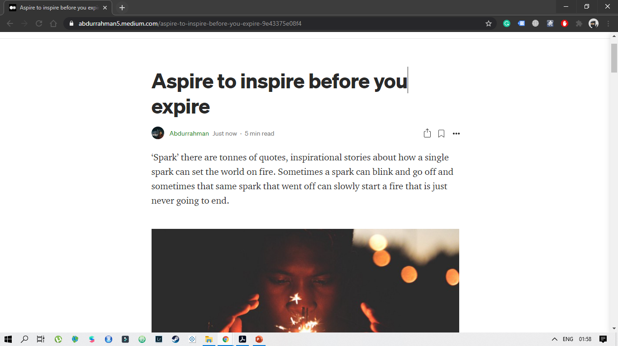
A glimpse of the article

Slide 4
Aspire to inspire before you expire
The article opens up with a small view of a Spark and what power it possesses
The question of isms and doctrines of life and what would one do in a different scenario, according to the question
And Later in article there’s a story of a prolific person
The story covers his view of the world and how he looks at it
His idea of creativity and innovation
And How he contributed to helping others by his innovative idea

Slide 5

Be
Original.
C
Be Creative
I
Be Innovative
I
// Don’t try to imitate someone else
Be Intuitive
U
Be unique

Slide 6
THANK YOU
Medium article Link: https://abdurrahman5.medium.com/aspire-to-inspire-before-you-expire-9e43375e08f4
Slideshare Link: https://www2.slideshare.net/AbdurrahmanKhan19/aspire-to-inspire-before-you-expire
Github Link: https://github.com/abdurrahmanKhan/Internship-TSF
LinkedIn Profile Link: www.linkedin.com/in/abdurrahman-163a63127
The Sparks Foundation Website: https://www.thesparksfoundationsingapore.org/

